Slide 1
Brain Gain
Promoting research and innovation
Team
Nandan Daga
Saurabh Deshmukh
Akash Doifode
Neelotpal Patel
Nikhil Mohite

Slide 2
Government
Funding
Funding
Research and Development Institutes and Universities
Product
and Public
Sector
Undertaking (PSU`s)
Human Resource
Human Resource
Private Sector
Funding

Slide 3
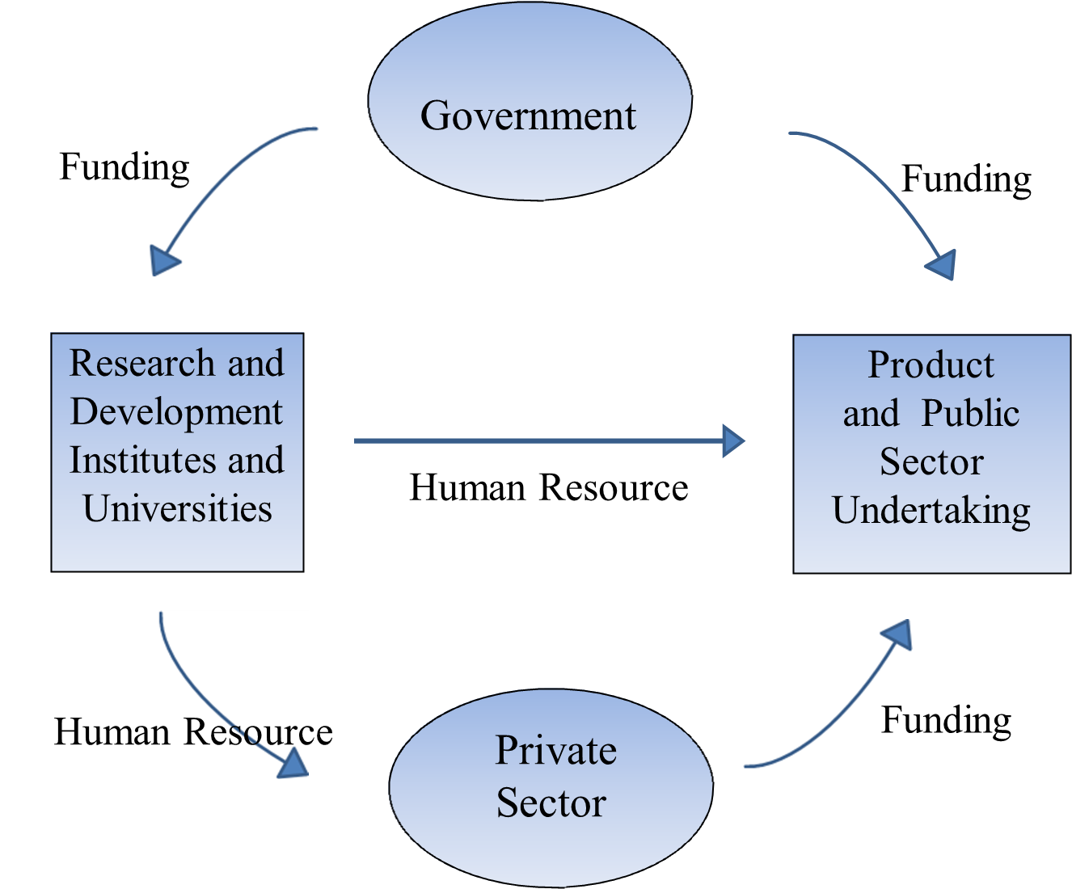
The Solution

Slide 4

Challenges while implementing solution
Time constraint: Time required for documenting and implementing the solution.
Oppose and acceptability of private sectors
Political will : Involvement of political people for implementing this solution faster.
Corruption: Controlling Corruption while funding money and building infrastructure .
Lack of mutual understanding and coordination between Public and Private Sector.
Lack of Resources : Resources like guide , research papers , tools , laboratories which are not available.
Coordination of local and global research universities may be problematic due to their own rules and regulations.
To recruit higher bodies like CAG for auditing research expenditure of Universities requires extra manpower and honesty.

Slide 5
Impact
Defence

